Slide 1



F
I
R
S
T
C
O
R
N
A
N
I
T
H
I
S
13.1-8a
A free CD of this message will be available following the service
It will also be available for podcast later this week at calvaryokc.com

Slide 2
1 Pet. 4:7-8 - ⁷ But the end of all things is at hand; therefore be serious and watchful in your prayers. ⁸ And above all things have fervent love for one another, for “love will cover a multitude of sins.”
Fervent - assiduous (marked by care and effort), tenacious
O
A
N
S
13.1-8a
I
I
F
I
R
S
T
C
R
N
T
H

Slide 3

O
A
N
S
13.1-8a
I
I
F
I
R
S
T
C
R
N
T
H

Slide 4

Chapter
twelve
Chapter
Thirteen
Chapter
fourteen
O
A
N
S
13.1-8a
I
I
F
I
R
S
T
C
R
N
T
H

Slide 5
Chapter
twelve
Chapter
Thirteen
Chapter
fourteen
Power
Love
2 Tim. 1:7 - For God has not given us a spirit of fear, but of power and of love and of a sound mind.
Sound mind
O
A
N
S
13.1-8a
I
I
F
I
R
S
T
C
R
N
T
H

Slide 6
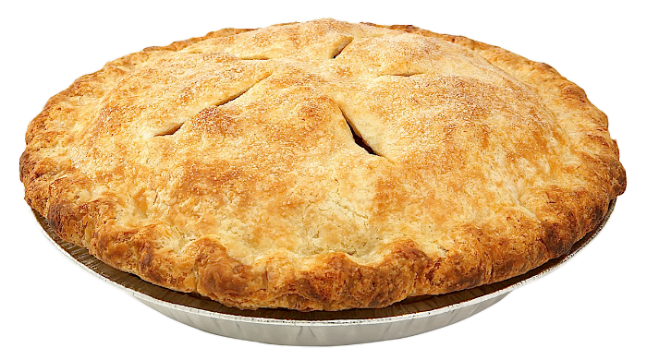
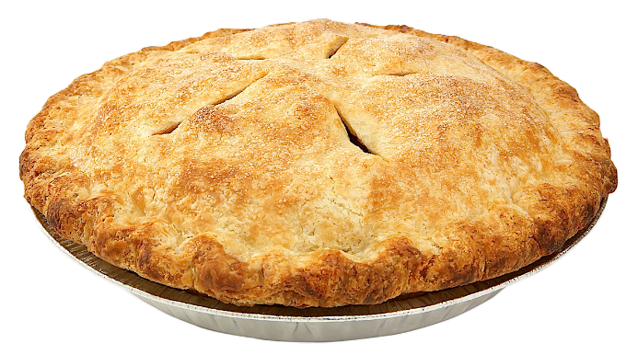
O
A
N
S
13.1-8a
I
I
F
I
R
S
T
C
R
N
T
H

Slide 7
The Four Loves
Sexual love - eros
Family love - storgos
Eros and storgos not in the New Testament
Brotherly love - Philos
Christian love - agapē
O
A
N
S
13.1-8a
I
I
F
I
R
S
T
C
R
N
T
H

Slide 8
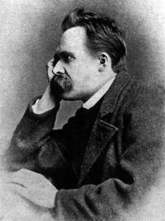
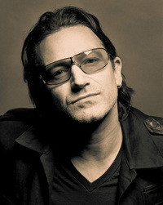
Fredrich Nietzsche - “In truth, there was only one Christian and he died on the cross.”
Bono - “Christians are hard to tolerate; I don’t know how Jesus does it.”
O
A
N
S
13.1-8a
I
I
F
I
R
S
T
C
R
N
T
H

Slide 9
Gal. 5:23-24a - ²² But the fruit of the Spirit is love, joy, peace, longsuffering, kindness, goodness, faithfulness, ^{23a} gentleness, self- control.
Fruit - karpas (sing.) not karpoi (pl.)
O
A
N
S
13.1-8a
I
I
F
I
R
S
T
C
R
N
T
H

Slide 10
kind-ness
good-
ness
self-control
joy
peace
longsuffering
gentleness
faithfulness
Love
O
A
N
S
13.1-8a
I
I
F
I
R
S
T
C
R
N
T
H

Slide 11
Love – KJV, charity
O
A
N
S
13.1-8a
I
I
F
I
R
S
T
C
R
N
T
H

Slide 12
Suffers long - makrothumia – ability to be wronged and not retaliate
O
A
N
S
13.1-8a
I
I
F
I
R
S
T
C
R
N
T
H

Slide 13
Adam Clarke - “They are ever willing that others should be preferred before them.”
O
A
N
S
13.1-8a
I
I
F
I
R
S
T
C
R
N
T
H

Slide 14
Provoked - KJV, NIV – easily
Phillips - It is not touchy.
O
A
N
S
13.1-8a
I
I
F
I
R
S
T
C
R
N
T
H

Slide 15
Thinks - logizomai – logic
NASB - does not take into account a wrong suffered,
NIV - keeps no record of wrongs.
O
A
N
S
13.1-8a
I
I
F
I
R
S
T
C
R
N
T
H

Slide 16
Bears all things - literally, covers
NIV – always protects
C. H. Spurgeon - “Love stands in the presence of a fault, with a finger on her lip.”
O
A
N
S
13.1-8a
I
I
F
I
R
S
T
C
R
N
T
H

Slide 17
Endures - hupomenō – bears everything with triumphant fortitude
O
A
N
S
13.1-8a
I
I
F
I
R
S
T
C
R
N
T
H

Slide 18
J. B. Phillips, Your God is Too Small – ”God may thunder His commands from Mount Sinai and men may fear, yet remain at heart exactly as they were before. But let a man once see his God down in the arena as a
O
A
N
S
13.1-8a
I
I
F
I
R
S
T
C
R
N
T
H

Slide 19
Man, – suffering, tempted, sweating, and agonized, finally dying a criminal's death - and he is a hard man indeed who is untouched.”
O
A
N
S
13.1-8a
I
I
F
I
R
S
T
C
R
N
T
H

Slide 20
The Devil’s Beatitudes
1. Blessed are those who are too tired, too busy,
too distracted to
Spend an hour once a
Week with their fellow Christians. They are my
best workers.
O
A
N
S
13.1-8a
I
I
F
I
R
S
T
C
R
N
T
H

Slide 21
The Devil’s Beatitudes
2. Blessed are those Christians who wait
to be asked and
expect to be thanked.
I can use them.
3. Blessed are the touchy that stop going to
church, they are my missionaries.
O
A
N
S
13.1-8a
I
I
F
I
R
S
T
C
R
N
T
H

Slide 22
The Devil’s Beatitudes
4. Blessed are the trouble makers, they shall be
called my children.
5. Blessed are the complainers, I'm all
ears to them.
O
A
N
S
13.1-8a
I
I
F
I
R
S
T
C
R
N
T
H

Slide 23
The Devil’s Beatitudes
6. Blessed are those who are bored with the
minister’s mannerisms
And mistakes. For they
shall get nothing out
of the sermons.
O
A
N
S
13.1-8a
I
I
F
I
R
S
T
C
R
N
T
H

Slide 24
The Devil’s Beatitudes
7. Blessed is the church member who expects to
be invited to his own church for he is a part
of the problem instead
of the solution.
O
A
N
S
13.1-8a
I
I
F
I
R
S
T
C
R
N
T
H

Slide 25
The Devil’s Beatitudes
8. Blessed are those who gossip, for they shall
cause strife and
division that pleases
me.
9. Blessed are those who
are easily offended, for they will soon get angry and quit.
O
A
N
S
13.1-8a
I
I
F
I
R
S
T
C
R
N
T
H

Slide 26
The Devil’s Beatitudes
10. Blessed are those who do not give their offering
to carry On God's
work, for They are my helpers.
11. Blessed is he who pro-fesses to love God but hates his brother and sister for he shall be with me forever.
O
A
N
S
13.1-8a
I
I
F
I
R
S
T
C
R
N
T
H

Slide 27
The Devil’s Beatitudes
12. Blessed are you who, when you read this,
think it is about
other people and not yourself … I've got you
too!
O
A
N
S
13.1-8a
I
I
F
I
R
S
T
C
R
N
T
H

